Slide 1
Interactive Dashboard for Chronic Disease Data
Team Number: 003
Team Members: Jinglin Xu, Maggie Xia, Yang Lu, Haijiao Tao, Mingwei Zhu

Slide 2
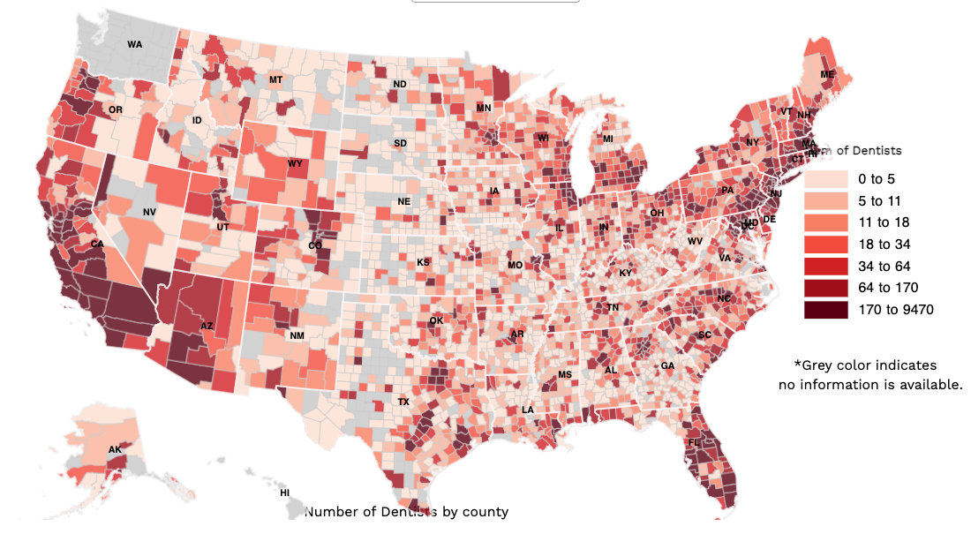
Motivations
Visualization: Develop an interactive map showcasing chronic disease distribution in the United States, emphasizing mortality and incidence rates.
Empowering Decision-Makers: Empower health professionals and government agencies with map-derived insights for informed decision-making, effective resource allocation, and enhanced healthcare outcomes in high-risk areas.

Slide 3


Dataset
CDC's Division of Population Health provides 124 standardized indicators, developed by consensus, for uniform chronic disease data collection and reporting by states, territories, and large metropolitan areas.
The CDI website acts as a gateway, offering state-specific indicator data and additional resources, improving accessibility for health practitioners and researchers.

Slide 4
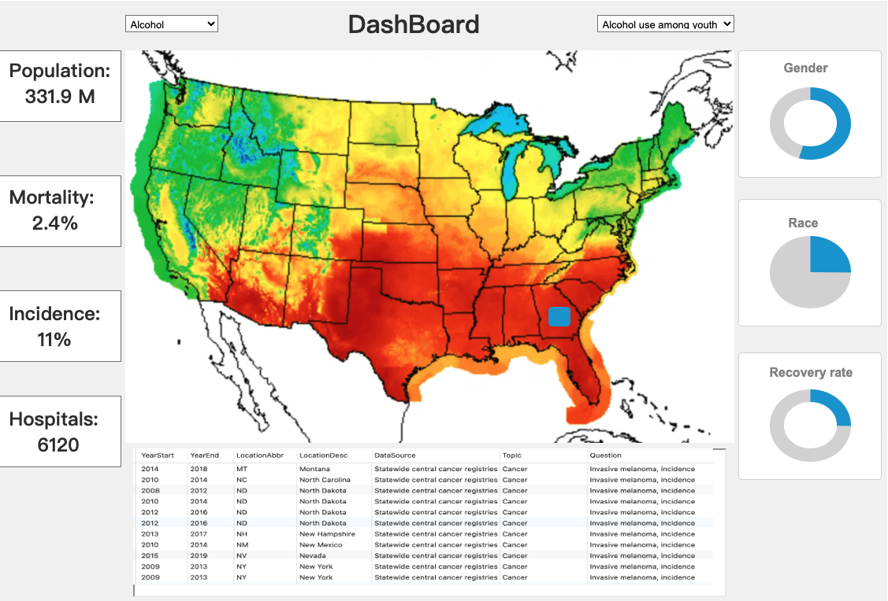
Dashboard

Slide 5
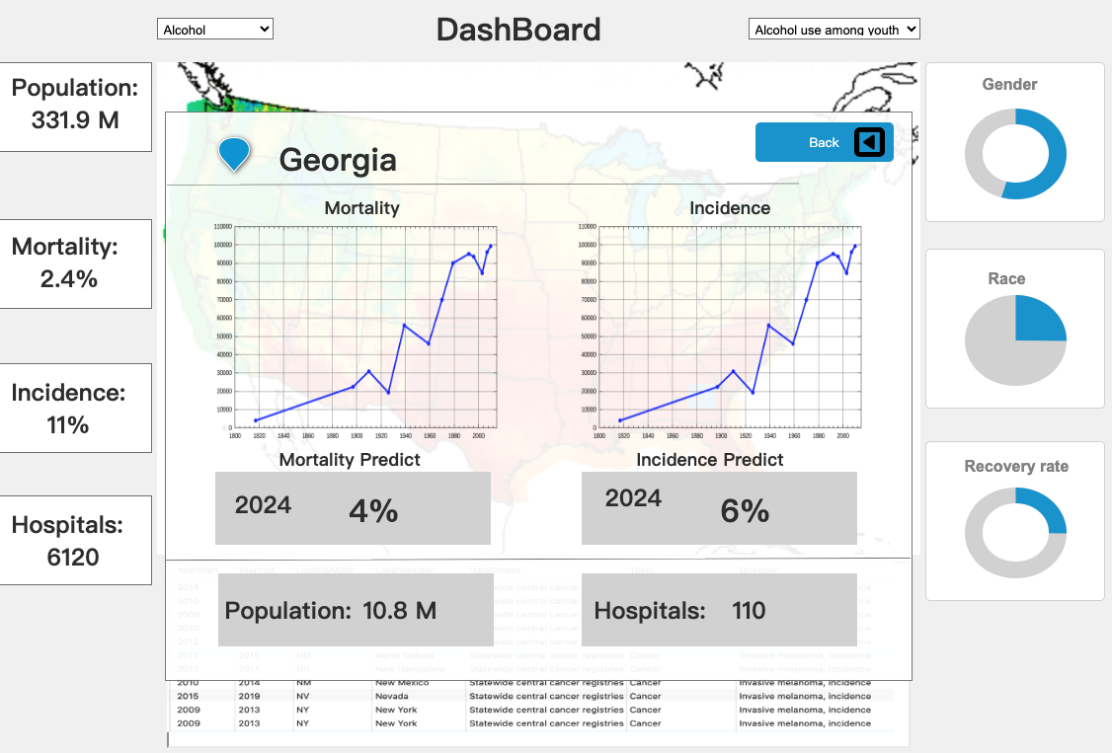
Dashboard

Slide 6
Thank you for listening

